Slide 1
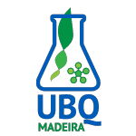
Entidad: Universidade dos Açores
Actividad 2.2.2. Biocatálisis (digestión de proteínas y polisacáridos) , caracterización de péptidos bioactivos a partir de biomasa de macroalgas de arribaziones y su interés industrial.
Proyecto demostrativo y de transferencia tecnológica para ayudar a las empresas a desarrollar nuevos productos y procesos en el ámbito de la Biotecnología Azul de la Macaronesia
MACBIOBLUE
MAC/1.1b/086
Gran Canaria, 23 de febrero de 2017
Entidades participantes beneficiarias y de Terceros Países:
Participantes asociados:

Slide 2
Índice
Introduction
Objectives
Protein hydrolysis
Bioactivities
Polysaccharide hydrolysis
Main deliverables

Slide 3
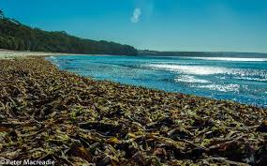
MACBIOBLUE
Introduction
Macroalgae wrack (port. “arrojamentos”, cast . “arribaziones”)
Significant in Canary islands, in Azores less common, inexistent in Madeira.
Azores – S. Maria & Pico
Sargassum, Dictyota, Asparagopsis, Colpomenia & other fragile Rhodophyta
Cystoseira & other intertidal species also interesting as sources of added-value compounds (previous studies from our group)

Slide 4
MACBIOBLUE
Objectives
Identify bioactive algal peptides and / or poly (or oligo) sacccharides, with pharmacological or biotechnological application
Characterize the molecules and their action mechanism
Optimize extraction, separation and purification for industrial use
Transfer results to Industry / SMEs

Slide 5
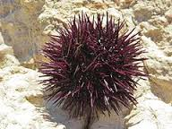
MACBIOBLUE
Polysaccharide hydrolysis:
Macroalgae polysaccharides (ulvans, fucoidans & others) – need specific hydrolyzing enzymes (ex., from bacterial symbionts of herbivorous marine organisms )
Isolation of bacteria from Paracentrotus lividus , Sphaerechinus sp, Arbacea lixula
Algal lysis studies (models: Fucus, Ulva, Gelidium ) with isolated bacteria
Metagenomic study of these and other bacterial symbionts from marine herbivores

Slide 6
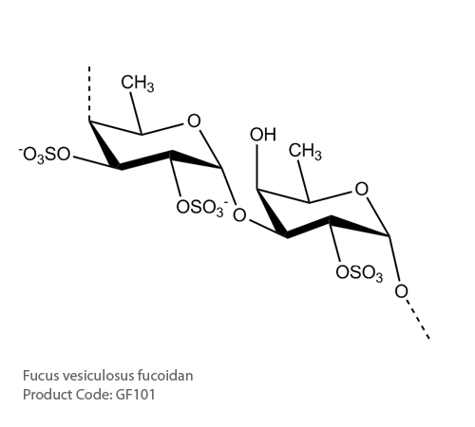
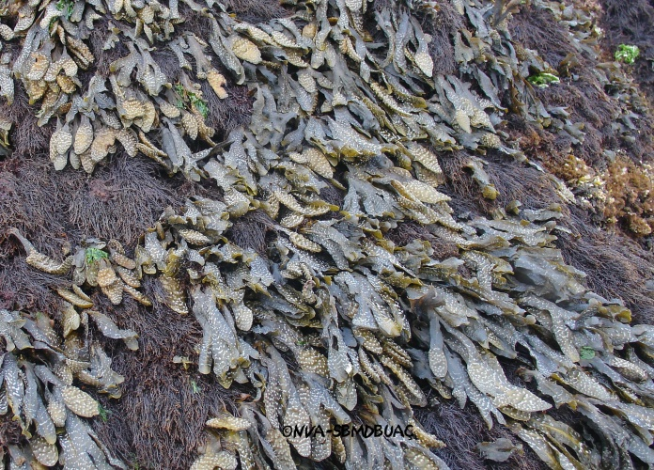
MACBIOBLUE
Separation & identification of polysaccharides / oligosaccharides by chromatographic methods
Bioactivity screening of polysaccharides / oligosaccharides

Slide 7
MACBIOBLUE
Protein hydrolysis
Search for bioactive peptides
Bioactivities:
Ex., ACE I inhibitors – ↓↓blood pressure

Slide 8
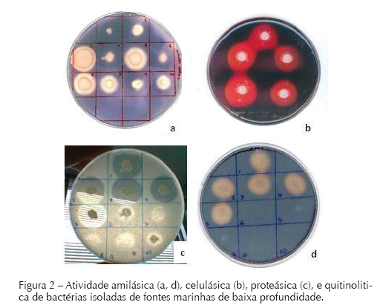
MACBIOBLUE
Controlled digestion by proteases from the Universidade dos Açores bacteria bank (ex., Bacillus, Archaea & others)
Optimization of hydrolysis – without & with previous polysaccharide degradation → proteins more accessible to protease action
Screening of hydrolisates for bioactivities
Separation of bioactive peptides by FPLC / other size exclusion chromatography / ultracentrifugation
Peptide characterization by MS / chromatographic methods / sequencing

Slide 9
MACBIOBLUE
Bioactivities
Anticancer
Antibacterial, antifungal
Antiaging
Induction of fibroblast and keranocyte growth
Increase in collagen and elastin synthesis in cells
Models based on Caenorhabdtis elegans and Drosophila melanogaster
Antioxidant
Immunomodulatory
Models based on Caenorhabdtis elegans

Slide 10
MACBIOBLUE
Bioactivities
Insecticide, antifeedant, moluscicide, nematicide
(environmentally-friendly pesticides / repellants)
Angiotensin Converting Enzyme II inhibitors
(blood pressure control)
Cholinesterase inhibitors
(Alzheimer’s Disease therapy)

Slide 11
MACBIOBLUE
Main Deliverables
3 patents for bioactive peptides and/or polysaccharides
Extraction & separation process for industry
Manual of technical procedures for industry

